Slide 1

The Android App Market on Google Play
Olfat Mostafa
Nourhan Ahmed
Yasmine Zakaria
Yasmeen Khaled
Marina Makram

Slide 2
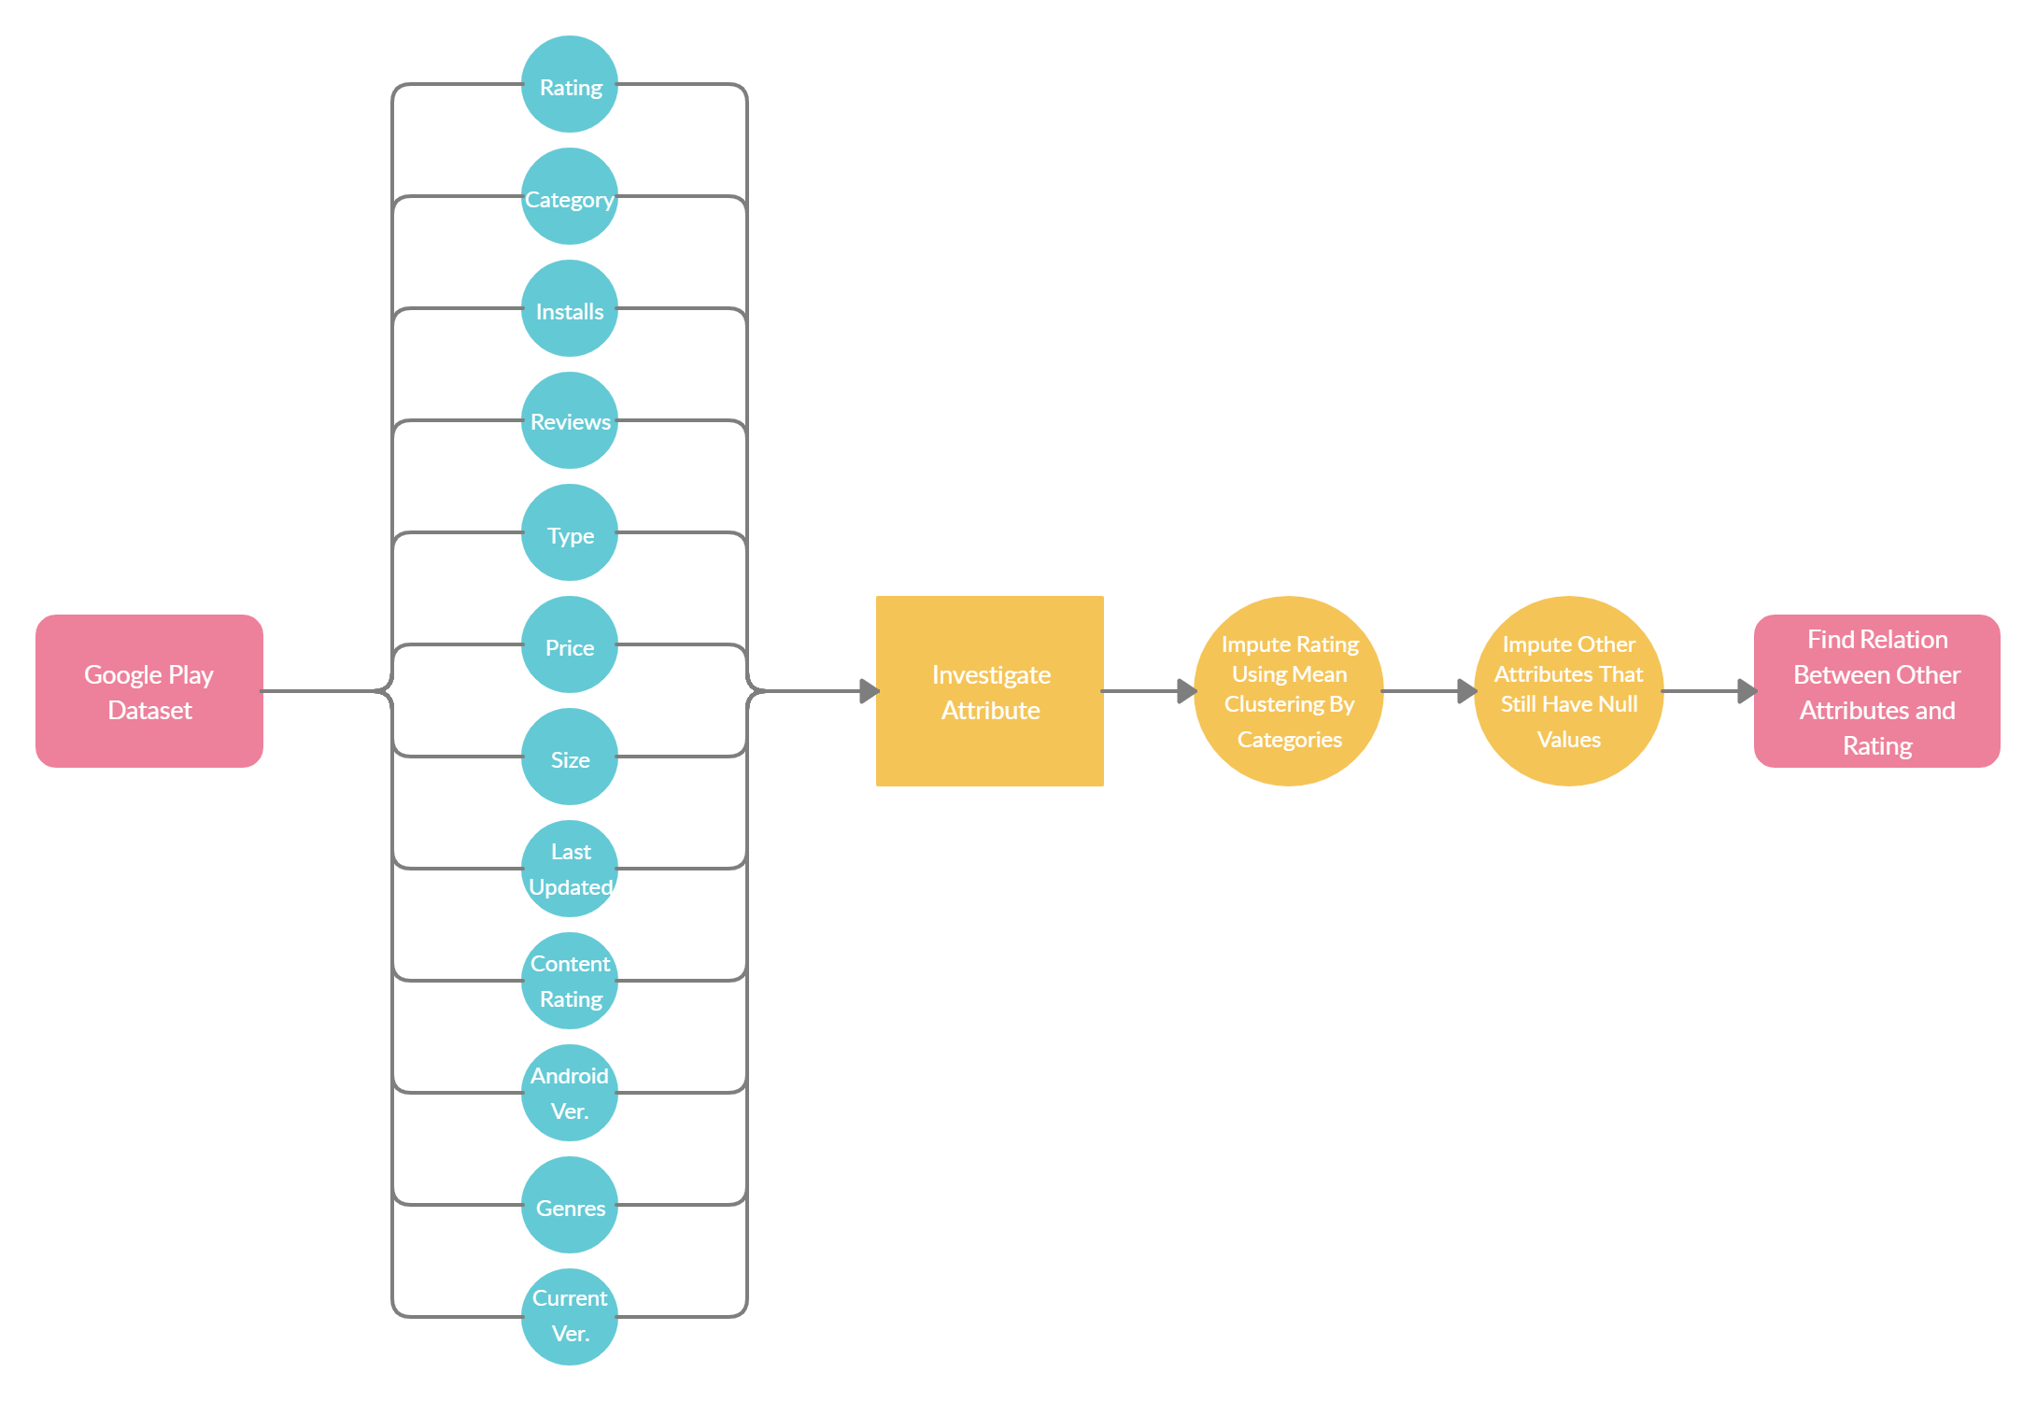
How To Get High Rating App?

Slide 3
Yasmeen Khaled has worked on Rating, Genres and Category column.​
Marina has worked on Type and Price columns.​
Yasmine Zakaria has worked on Rating, Content Rating and Current Ver. columns.​
Olfat has worked on Android Ver. and Last Updated columns.​
Nourhan Ahmed has worked on Rating, Installs, Size, Reviews columns.​
NB: All team members has worked on finding the relation between the column they worked on and Rating column to answer our main question.​
Work Distribution

Slide 4
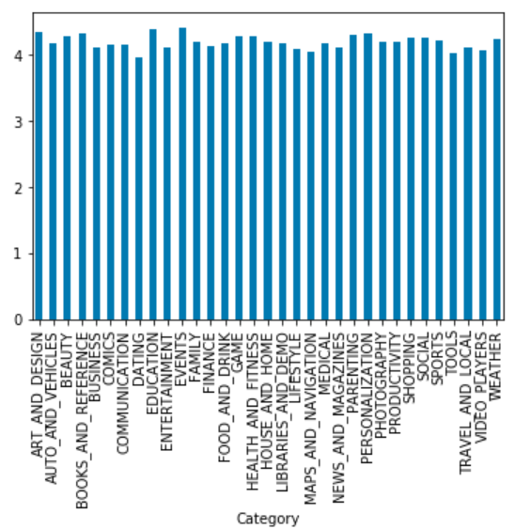
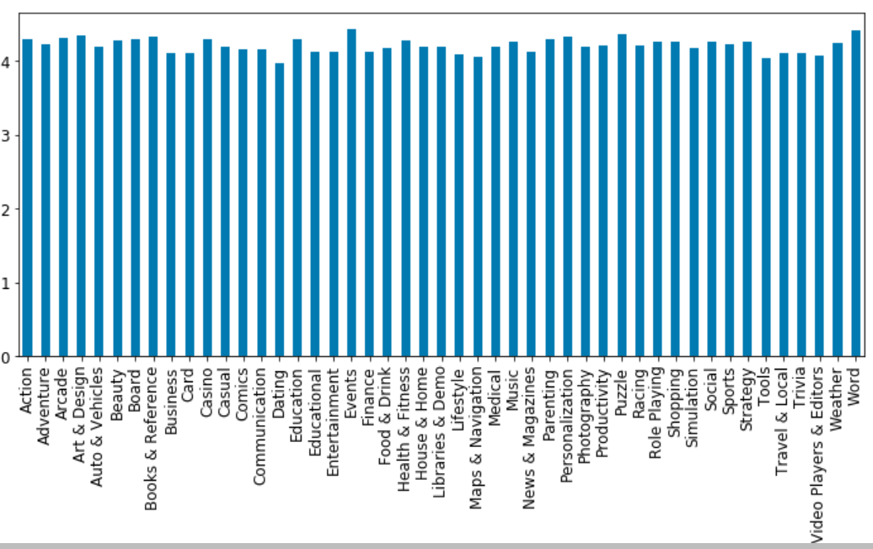
Category,Genre vs Rating
Rating column values range from 1 to 5, a record with rating 19 was removed. It had 13% null values.
Category column had 34 unique values, one record was removed which had a category type “1.9”.
Genres column had the main genres;subgenres with 119 records, where the values counts for the genre;subgenres was very low so the column was converted to main genres only, converting unique values to be 47.
Family was the most mentioned category, while Tools was the most mentioned genre.
Both category and Genre columns showed that they don’t affect the average rating .
After investigating the rating vs category, it was discovered that most of the apps have a very close rating with in the category in most of the cases that is why we imputed the missing rating with the category mean.

Slide 5
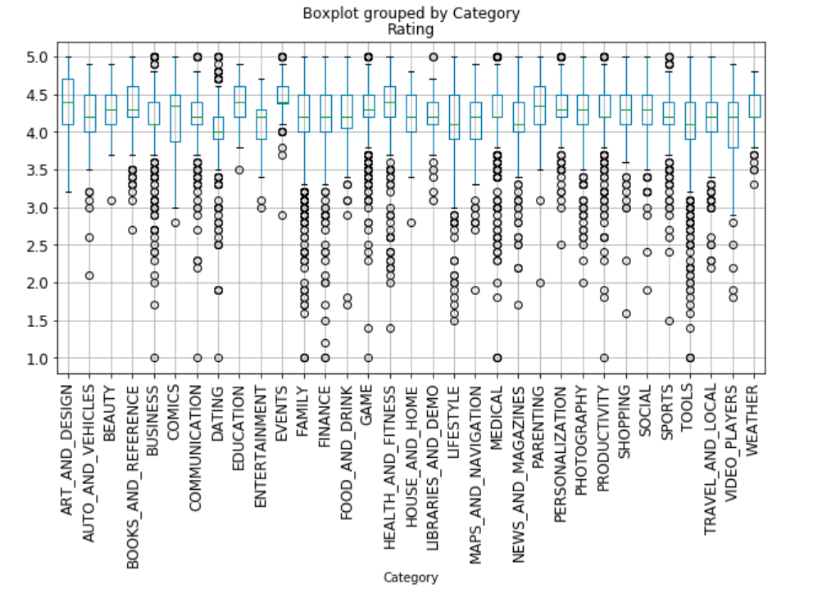
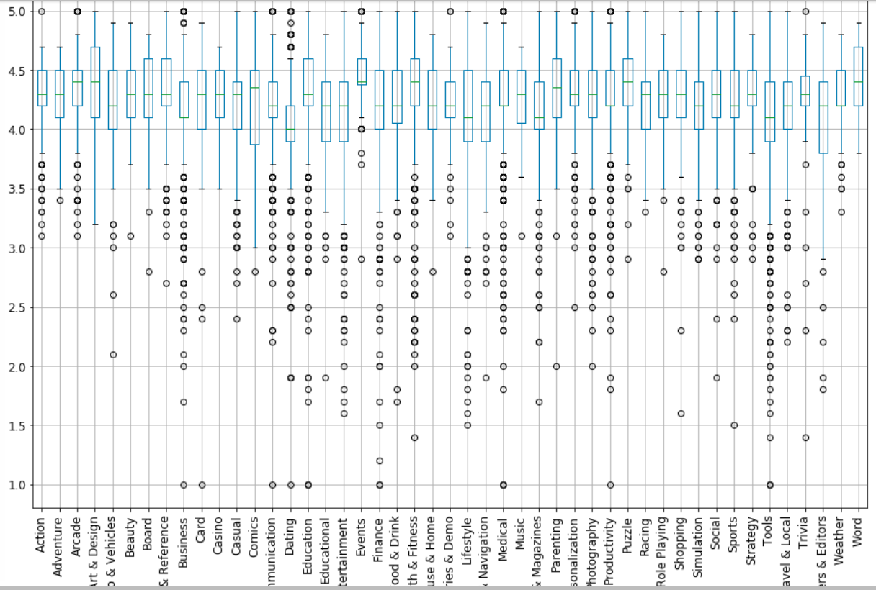

Slide 6
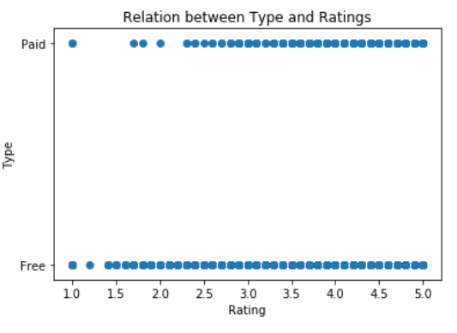
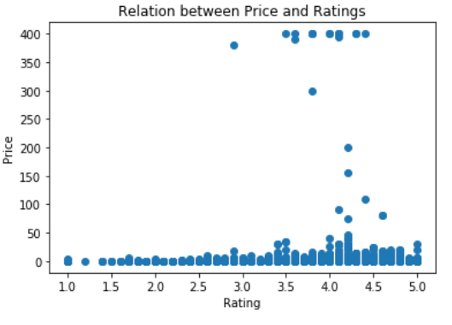
Type, Price vs Rating
Type column split records into paid and free apps, where most of apps are free.
Only one app has no value for type so it will have free value as free contributes with 93% of the total number of apps.
As clearly shown in the figure there is no relation between Type and Rating.
Price column has apps starting from 0$ to 400$, where most of apps has 0 value ‘Free’.
As shown in the figure that only apps with high price don’t have low rating.
To ensure if there is a relation or not we used corr method and it gave very low value that can be neglected.

Slide 7
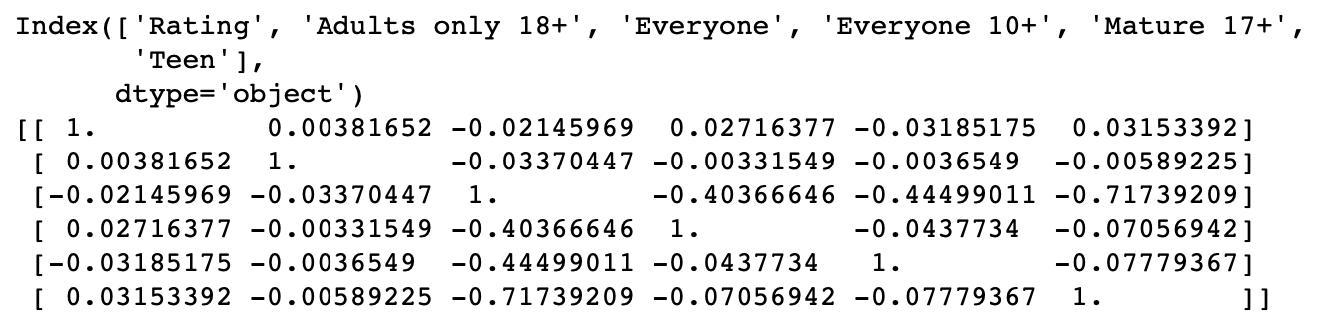

Content Rating, Current Version vs Rating
Very poor correlation between Content Rating and app rating
Mean Rating of each content rating is very near to each other with range (4.1 - 4.2) except for Adults and Teens its mean is higher than others with range(4.3 - 4.5). We can conclude that apps with smaller targeted group "Content Rating" have higher probability of getting higher rating than other apps with wider targeted group.
Very poor correlation between number of produced versions and app rating
The small relation value may be caused as the way used to calculate number of produced versions may be not correct as each app uses different version format so finding a way that translates every format is a hard task.

Slide 8
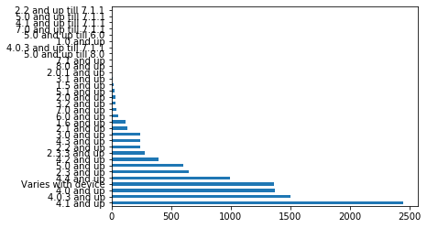
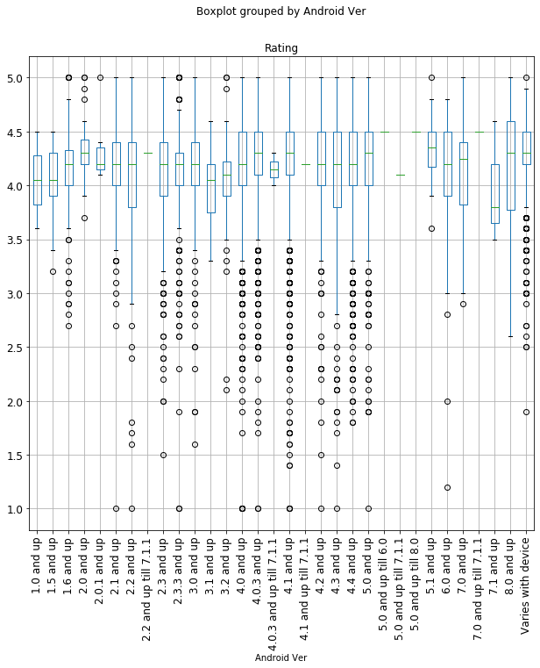
Android Ver vs Rating
Missing values in Android Ver: 2
The missing values were imputed by varies by device
Inconsistent representations of the android ver col were unified to match the most common representation
Conclusion after cleaning is: The majority of the apps in the dataset require that mobile phones has an android version that's higher than 4.1
There is no correlation between rating and Android ver

Slide 9
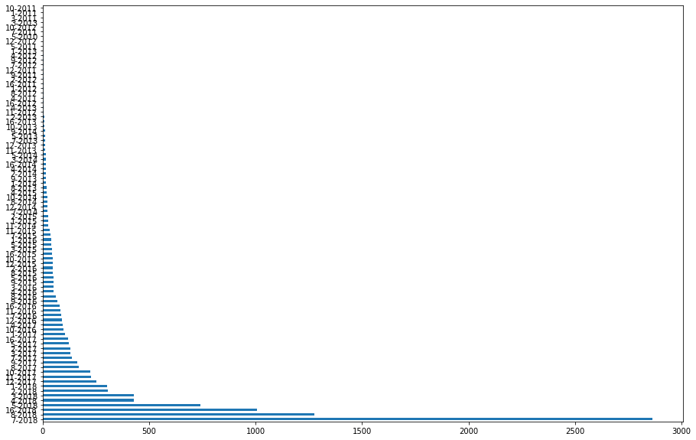
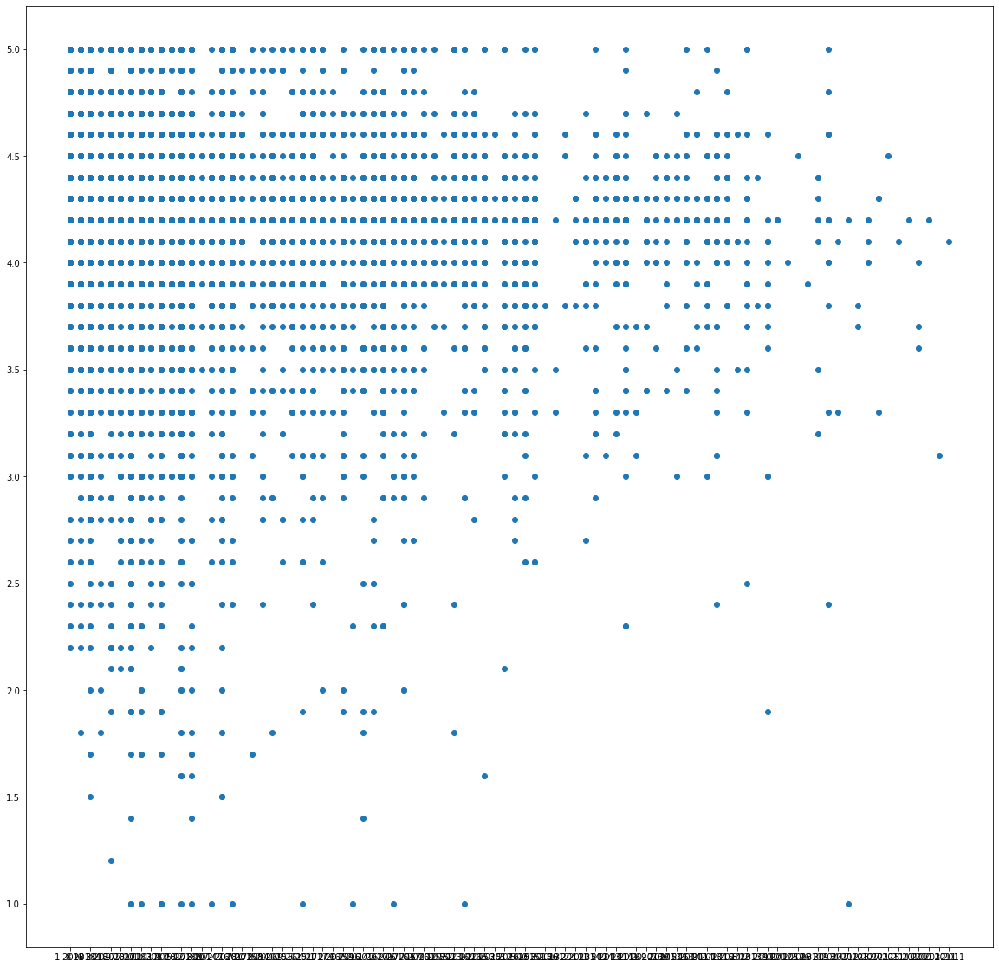
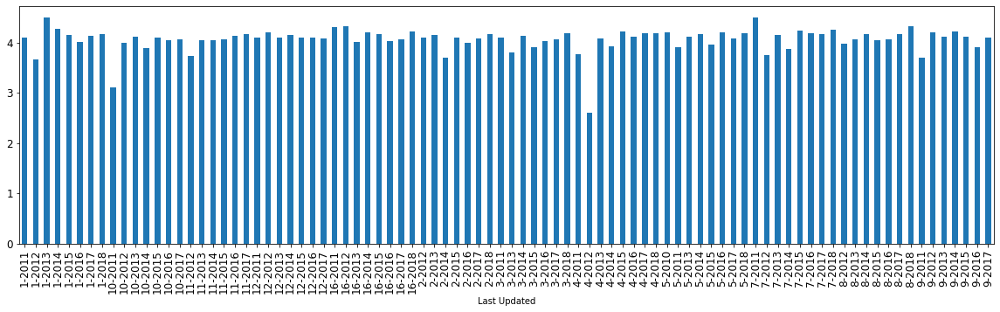
Last Updated vs Rating
Missing values in Last Updated: 0
The last updated column has a non unified representation of dates so converting this representation would make investigating more reliable, also it has too many unique values so formatting it to exclude the day and only keep the month and year makes it more easy to visualize.
As shown from both the scatter plot and the bar chart the rating has no relation whatsoever with date when it was last updated, the scatter plot shows no grouping or shape of scattered points and the bar chart shows that the rating is mostly always slightly less than or more than or equal to 4

Slide 10
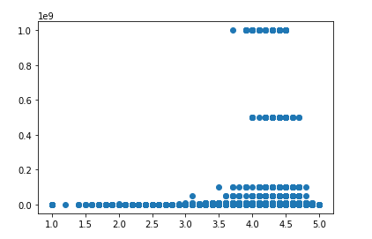
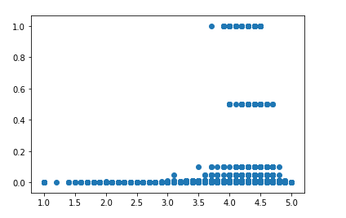
Installs vs Rating
Transformation of installs column into numerical attribute by removing the plus sign .
Correlation between installs and Rating investigated using a scatter plot.
Values of the installs are too huge so Normalization (Min-Max method )is applied to the installs column to rescale the installs values from zero to 1.
After Normalization of installs the scatter plot is used again to
investigate the correlation with Rating but still no correlation.

Slide 11
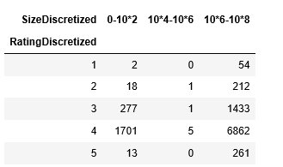
Size vs Rating
The size attribute has a value called Varies with device.
This column has a meaning so it can’t be replaced by other
Numerical value.
Transforming the size attribute into numerical.
Discretizing the Numerical values of the size to have it as
a categorical attribute.
Use the chi_square test to investigate the relation of the Rating with the size.
But this needs the Rating attribute to be Categorical!
Transform the Rating attribute into a categorical attribute by removing the decimal point so that we have values between 1 and 5.
The chi-square test revealed a correlation between the size and the Rating as it produced a p-value of 2.4546967229331673e-14.

Slide 12
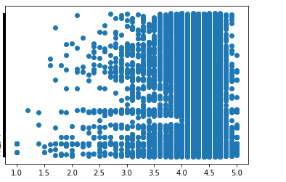
Reviews vs Rating
Reviews attribute is a Numerical attribute with no missing values.
Correlation between it and the Rating is investigated using a
Scatter plot .
The scatter plot revealed that there is no
correlation between the Rating and Reviews.

